Slide 1
Chapter 9
Getting Started with Floating Point

Slide 2

FLOATING-POINT DATA TYPE
Single-precision floating-point (float)
Excess-127 format
2⁰ → 01111111
Normalized: MS-Bit is always 1; never stored
31
30
23
22
0
±
Exponent
Significand
8 bits
23 bits
Range: 2^{±127} ≈ 10^{±38}
Precision: 23 bits ≈ 7 decimal digits
0 if positive,
1 if negative
The Cortex-M4 FPU doesn't support data type double.

Slide 3
float versus int32_t
31 |  |  |  |  |  |  |  |  |  |  |  |  |  |  |  |  |  |  |  |  |  |  |  |  |  |  |  |  |  |  | 0
0 | 0 | 0 | 0 | 0 | 0 | 0 | 0 | 0 | 0 | 0 | 0 | 0 | 0 | 0 | 0 | 0 | 0 | 0 | 0 | 0 | 0 | 1 | 1 | 1 | 1 | 1 | 0 | 1 | 0 | 0 | 0
int32_t y = 1000 ;
float x = 1000. ;
31 | 30 | excess 127 exponent |  |  |  |  |  | 23 | 22 | significand |  |  |  |  |  |  |  |  |  |  |  |  |  |  |  |  |  |  |  |  | 0
0 | 1 | 0 | 0 | 0 | 1 | 0 | 0 | 0 | 1 | 1 | 1 | 1 | 0 | 1 | 0 | 0 | 0 | 0 | 0 | 0 | 0 | 0 | 0 | 0 | 0 | 0 | 0 | 0 | 0 | 0 | 0
136₁₀
0.953125
value = + 1.953125 × 2^{(136 – 127)}
http://www.h-schmidt.net/FloatConverter/IEEE754.html

Slide 4
FLOATING-POINT REGISTERS
32 bits
S0
D0
S1
S0-S15 may be modified by functions
.
.
.
…
D0-D15 may be used to hold 64-bit values, but all floating-point arithmetic is 32-bits.
…
S14
D7
S15
S16
D8
S17
S16-S31 must be preserved by functions
…
.
.
.
…
S30
D15
S31

Slide 5
FLOATING-POINT PUSH & POP
Instruction | Syntax | Operation
Push FPU Registers | VPUSH register list | SP ← SP – 4 × #registers, copy registers to mem[SP]
POP FPU Registers | VPOP register list | Copy mem[SP] to registers SP ← SP + 4 × #registers
Use these instructions at function entry and exit to preserve and restore any of the registers S16-S31 that are modified.

Slide 6
FUNCTION PARAMETERS AND RETURN VALUES
Function call in C | Function call in assembly
float Hypotenuse(float, float) ; float side1, side2, side3 ; ● ● ● side3 = Hypotenuse(side1, side2) ; ● ● ● | ● ● ● VLDR S0,side1 // left-most param VLDR S1,side2 // second param BL Hypotenuse ADR R0,side3 // get &save3 VSTR S0,[R0] // save result ● ● ●
Floating-point parameters are passed in S0-S15, in left-to-right order.
Floating-point function result is returned in S0. (VSTR needs adrs in a reg.)

Slide 7




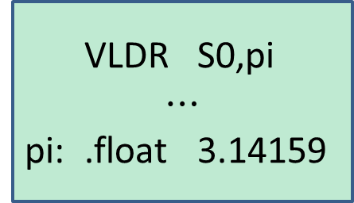
LOADING FLOATING-POINT CONSTANTS
Integer
Floating Point
Floating Point
MOV R0,5
VMOV S0,3.14159
VMOV S0,0.5
VMOV only works with a limited set of constants.
Integer
Floating Point
Floating Point
LDR R0,=5
VLDR S0,=3.14159
VLDR S0,pi
$$⋯$$
pi: .float 3.14159
VLDR cannot be used as a pseudo-instruction.

Slide 8
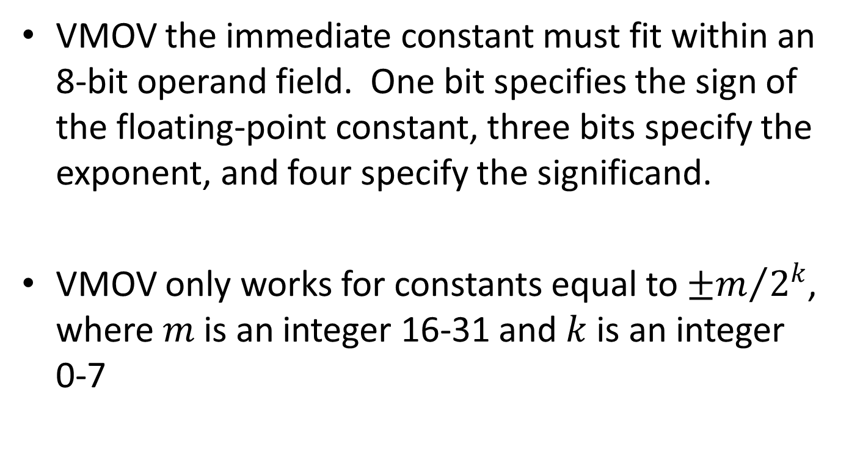
VMOV Immediate Constants
VMOV the immediate constant must fit within an 8-bit operand field. One bit specifies the sign of the floating-point constant, three bits specify the exponent, and four specify the significand.
VMOV only works for constants equal to ${±m}/{2^{k}}$, where $m$ is an integer 16-31 and $k$ is an integer 0-7

Slide 9
VMOV Immediate Constants
0.125 0.1328125 0.140625 0.1484375 0.15625 0.1640625 0.171875 0.1796875 0.1875 0.1953125 0.203125 0.2109375 0.21875 0.2265625 0.234375 0.2421875 | 0.25 0.265625 0.28125 0.296875 0.3125 0.328125 0.34375 0.359375 0.375 0.390625 0.40625 0.421875 0.4375 0.453125 0.46875 0.484375 | 0.5 0.53125 0.5625 0.59375 0.625 0.65625 0.6875 0.71875 0.75 0.78125 0.8125 0.84375 0.875 0.90625 0.9375 0.96875 | 1.0 1.0625 1.125 1.1875 1.25 1.3125 1.375 1.4375 1.5 1.5625 1.625 1.6875 1.75 1.8125 1.875 1.9375 | 2.0 2.125 2.25 2.375 2.5 2.625 2.75 2.875 3.0 3.125 3.25 3.375 3.5 3.625 3.75 3.875 | 4.0 4.25 4.5 4.75 5.0 5.25 5.5 5.75 6.0 6.25 6.5 6.75 7.0 7.25 7.5 7.75 | 8.0 8.5 9.0 9.5 10.0 10.5 11.0 11.5 12.0 12.5 13.0 13.5 14.0 14.5 15.0 15.5 | 16.0 17.0 18.0 19.0 20.0 21.0 22.0 23.0 24.0 25.0 26.0 27.0 28.0 29.0 30.0 31.0

Slide 10
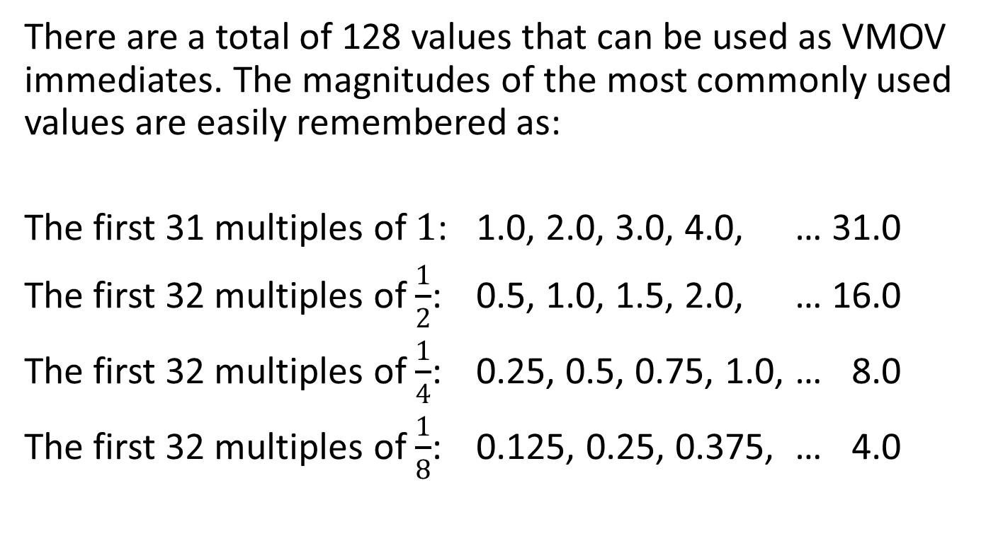
Common VMOV Immediates
There are a total of 128 values that can be used as VMOV immediates. The magnitudes of the most commonly used values are easily remembered as:
The first 31 multiples of $1$: 1.0, 2.0, 3.0, 4.0, … 31.0
The first 32 multiples of $\frac{1}{2}$: 0.5, 1.0, 1.5, 2.0, … 16.0
The first 32 multiples of $\frac{1}{4}$: 0.25, 0.5, 0.75, 1.0, … 8.0
The first 32 multiples of $\frac{1}{8}$: 0.125, 0.25, 0.375, … 4.0

Slide 11
Checking a VMOV Constant
To see if VMOV can use a particular value, multiply it by successive powers of 2 from 1 to 128 (i.e., double it up to 7 times).
If the original value or any of the products is a whole number between 16 and 31, then the floating-point value may be used as a VMOV immediate.

Slide 12
COPYING FLOATING-POINT DATA Register to Register
Instruction | Syntax | Operation
Move FP Register to FP Register | VMOV S_{d},S_{m} | S_{d} ← S_{m}
Move FP Register to Core Register | VMOV R_{d},S_{m} | R_{d} ← S_{m}
Move Core Register to FP Register | VMOV S_{d},R_{m} | S_{d} ← R_{m}
Move 2 FP Registers to Core Registers | VMOV R_{t},R_{t2},S_{m},S_{m1} | R_{t} ← S_{m} ; R_{t2} ← S_{m1} Note: m1 = m + 1
Move 2 Core Registers to FP Registers | VMOV S_{m},S_{m1},R_{t},R_{t2} | S_{m} ← R_{t} ; S_{m1} ← R_{t2} Note: m1 = m + 1
These only copy data. They do NOT convert between integer and floating-point representations.

Slide 13
COPYING FLOATING-POINT DATA Memory to (Single or Double) Register
Instruction | Syntax | Operation
Load single-precision FPU Register from Memory | VLDR S_{d},[R_{n}] | S_{d} ←mem₃₂[R_{n}]
 | VLDR S_{d},[R_{n},constant] | S_{d} ←mem₃₂[R_{n} + constant]
 | VLDR S_{d},label | S_{d} ←mem₃₂[adrs of label]
Load double-precision FPU Register from Memory | VLDR D_{d},[R_{n}] | D_{d} ←mem₆₄[R_{n}]
 | VLDR D_{d},[R_{n},constant] | D_{d} ←mem₆₄[R_{n} + constant]
 | VLDR D_{d},label | D_{d} ←mem₆₄[adrs of label]

Slide 14
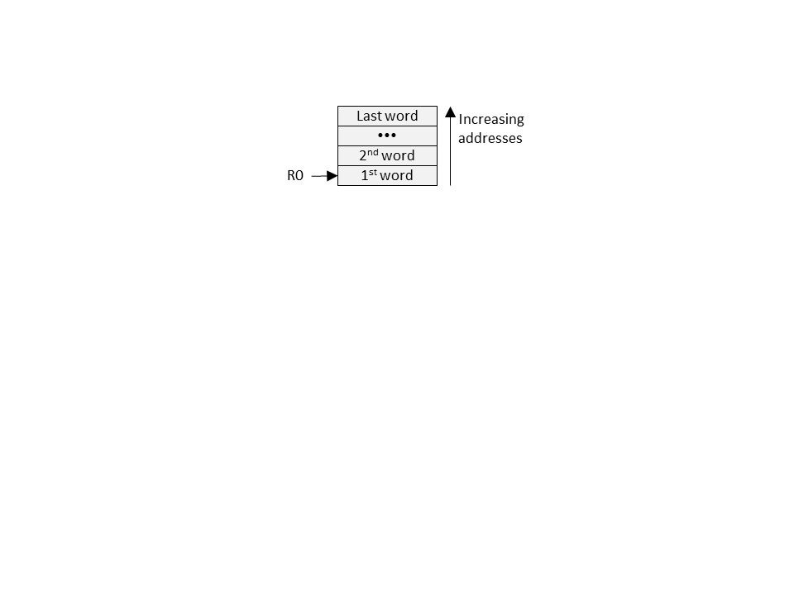
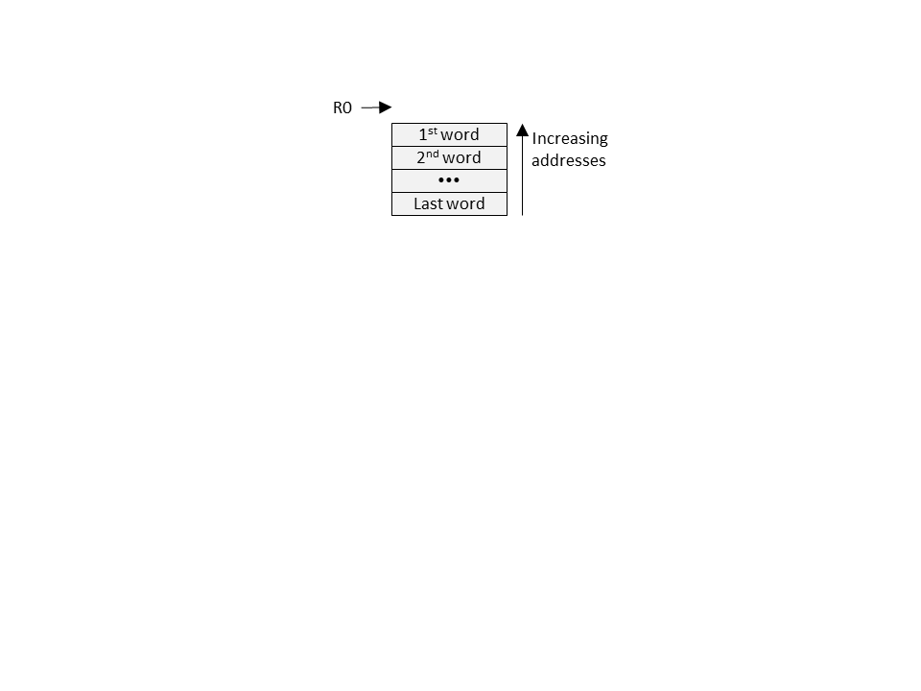
COPYING FLOATING-POINT DATA Memory to Multiple Registers
Instruction | Syntax | Operation
Load Multiple FPU Registers, Increment After | VLDMIA R_{n}!,register list | FP registers ← memory, 1st address in R_{n}; Updates R_{n} only if write-back flag (!) is appended to R_{n}.
Load Multiple FPU Registers, Decrement Before | VLDMDB R_{n}!,register list | FP registers ← memory, addresses end just before address in R_{n}; Must append (!) and always updates R_{n}
// Copy starting at mem[R0] VLDMIA R0!,{S0,S1,S2}
// Copy ending before mem[R0] VLDMDB R0!,{S0-S5}
VLDMIA SP!,{…} is the same as VPOP {…}

Slide 15
COPYING FLOATING-POINT DATA 1, 2 or Multiple Registers to Memory
Instruction | Syntax | Operation
Store single-precision FPU Register to Memory | VSTR S_{d},[R_{n}] | S_{d} → mem₃₂[R_{n}]
 | VSTR S_{d},[R_{n},constant] | S_{d} → mem₃₂[R_{n} + constant]
 | VSTR S_{d},label | S_{d} → mem₃₂[address of label]
Store double-precision FPU Register to Memory | VSTR D_{d},[R_{n}] | D_{d} → mem₆₄[R_{n}]
 | VSTR D_{d},[R_{n},constant] | D_{d} → mem₆₄[R_{n} + constant]
 | VSTR D_{d},label | D_{d} → mem₆₄[address of label]
Store Multiple FPU Registers, Increment After | VSTMIA R_{n}!,register list | FP registers → memory, 1st address in R_{n}; Updates R_{n} only if write-back flag (!) is appended to R_{n}.
Store Multiple FPU Registers, Decrement Before | VSTMDB R_{n}!,register list | FP registers → memory, addresses end just before address in R_{n}; Must append (!) and always updates R_{n}
Note: Using PC as R_{n} is deprecated
Note: Using PC as R_{n} is deprecated

Slide 16
CONVERTING BETWEEN INTEGER AND FLOATING POINT
Instruction | Syntax | Operation
Convert Unsigned Integer to Floating-Point (float ← uint32_t) | VCVT.F32.U32 S_{d},S_{m} | S_{d} ← (float) S_{m}, where S_{m} is an unsigned integer
Convert 2’s complement Integer to Floating-Point (float ← int32_t) | VCVT.F32.S32 S_{d},S_{m} | S_{d} ← (float) S_{m}, where S_{m} is a 2’s complement integer
Convert Floating-Point to Unsigned Integer (uint32_t ← float) | VCVT.U32.F32 S_{d},S_{m} | S_{d} ← (uint32_t) S_{m}
 | VCVTR.U32.F32 S_{d},S_{m} | S_{d} ← (uint32_t) S_{m} rounded
Convert Floating-Point to 2’s complement Integer (int32_t ← float) | VCVT.S32.F32 S_{d},S_{m} | S_{d} ← (int32_t) S_{m}
 | VCVTR.S32.F32 S_{d},S_{m} | S_{d} ← (int32_t) S_{m} rounded

Slide 17
ROUNDING MODES
Rounding Mode | IEEE Abbrev. | FPSCR bits 23..22 | Examples
 |  |  | -2.5 | -1.5 | +1.5 | +2.5
Round to nearest even (default) | ToNEAR | 00 | -2 | -2 | +2 | +2
Round towards positive infinity | ToPOSV | 01 | -2 | -1 | +2 | +3
Round towards negative infinity | ToNEGV | 10 | -3 | -2 | +1 | +2
Round towards zero (truncate) | ToZERO | 11 | -2 | -1 | +1 | +2
Default:
VCVTR uses ToNEAR
VCVT uses ToZERO

Slide 18
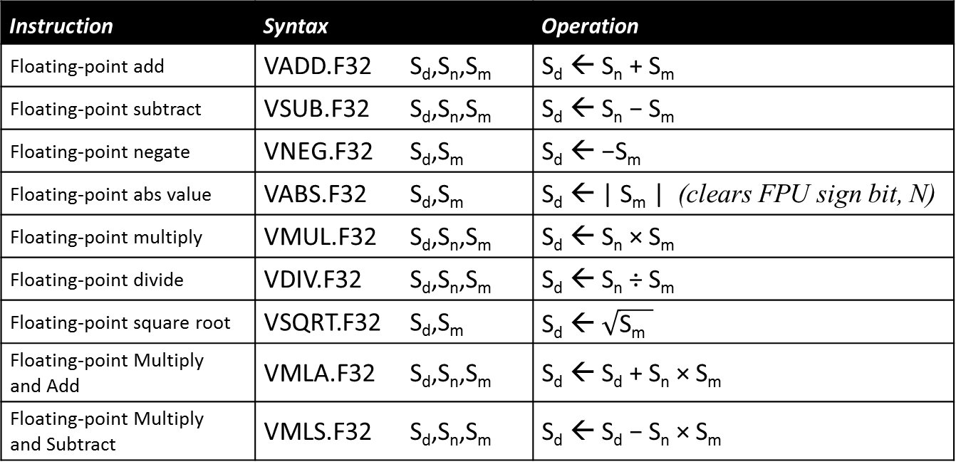
ARITHMETIC WITH REAL NUMBERS
Instruction | Syntax | Operation
Floating-point add | VADD.F32 S_{d},S_{n},S_{m} | S_{d} ← S_{n} + S_{m}
Floating-point subtract | VSUB.F32 S_{d},S_{n},S_{m} | S_{d} ← S_{n} − S_{m}
Floating-point negate | VNEG.F32 S_{d},S_{m} | S_{d} ← −S_{m}
Floating-point abs value | VABS.F32 S_{d},S_{m} | S_{d} ← | S_{m} | (clears FPU sign bit, N)
Floating-point multiply | VMUL.F32 S_{d},S_{n},S_{m} | S_{d} ← S_{n} × S_{m}
Floating-point divide | VDIV.F32 S_{d},S_{n},S_{m} | S_{d} ← S_{n} ÷ S_{m}
Floating-point square root | VSQRT.F32 S_{d},S_{m} | S_{d} ← $\sqrt{\text{S}\text{m} }$
Floating-point Multiply and Add | VMLA.F32 S_{d},S_{n},S_{m} | S_{d} ← S_{d} + S_{n} × S_{m}
Floating-point Multiply and Subtract | VMLS.F32 S_{d},S_{n},S_{m} | S_{d} ← S_{d} − S_{n} × S_{m}
In general, the floating-point arithmetic instructions do not set the flags.

Slide 19

Example: Pythagorean Theorem
$$diagonal= \sqrt{{side1}^{2}+ {side2}^{2}}$$
// float Diagonal(float side1, float side2) Diagonal: VMUL.F32 S0,S0,S0 // S0 = side1 * side1 VMLA.F32 S0,S1,S1 // S0 += side2 * side2 VSQRT.F32 S0,S0 // S0 = square root of S0 BX LR // Return
A function prototype declaration is needed when called to be sure parameters are single precision float.

Slide 20
COMPARING REAL NUMBERS
Instruction | Syntax | Operation
Floating-Point Compare two Registers | VCMP.F32 S_{d},S_{m} | Computes S_{d} - S_{m} and updates FPU flags in FPSCR
Floating-Point Compare Register to Zero | VCMP.F32 S_{d},#0.0 | Computes S_{d} - 0 and updates FPU flags in FPSCR
Move Flags from FPU FPSCR to core APSR | VMRS APSR_nzcv,FPSCR | Core CPU Flags ← FPU Flags
VMRS is required in order to test the value of a floating-point flag!

Slide 21
INTERPRETING FLAGS AFTER VCMP
Condition Code | VCMP Meaning
EQ (Equal) | ==
NE (Not Equal) | != or unordered
HS (Higher or Same) or CS (Carry Set) | ≥ or unordered
LO (Lower) or CC (Carry Clear) | <
HI (Higher) | > or unordered
LS (Lower or Same) | ≤
GE (Greater Than or Equal) | ≥
LT (Less Than) | < or unordered
GT (Greater Than) | >
LE (Less Than or Equal) | ≤ or unordered
MI (Minus) | <
PL (Plus) | ≥ or unordered
VS (Overflow Set) | unordered
VC (Overflow Clear) | not unordered
AL (Always) | unconditional

Slide 22
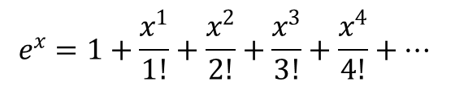
Example: Maclauren Series
$$e^{x}=1+\frac{x^{1}}{1!}+\frac{x^{2}}{2!}+\frac{x^{3}}{3!}+\frac{x^{4}}{4!}+…$$
// float eToX(float x, float minTerm) // Parameters: S0 = x, S1 = minTerm (assume minTerm >= 0) // Returns: Taylor series approximation of e raised to power x e2x: VMOV S2,1.0 // S2 = constant 1.0 VMOV S3,S2 // S3 = initial N = 1 VMOV S4,S2 // S4 = initial term = 1.0 VMOV S5,S2 // S5 = initial approx. = 1.0 next: VMUL.F32 S4,S4,S0 // term = term * x VDIV.F32 S4,S4,S3 // term = term / N VABS.F32 S6,S4 // S6 = |term| VCMP.F32 S6,S1 // Is |term| < minTerm ? VMRS APSR_nzcv,FPSCR // Flags to APSR for testing BLO done // If yes, then done! VADD.F32 S5,S5,S4 // else, add the term VADD.F32 S3,S3,S2 // N = N + 1 B next // go try the next term done: VMOV S0,S5 // Copy result into S0 BX LR // Return

Slide 23
Simple Floating-Point Example
float VolumeOfCube(float height, float width, float depth)
{
return height * width * depth ;
}
VolumeOfCube: // S0 = height, S1 = width, S2 = depth
VMUL.F32 S0,S0,S1 // S0 = height * width
VMUL.F32 S0,S0,S2 // S0 = height * width * depth
BX LR

Slide 24
Arbitrary Floating-Point Constants
float AreaOfCircle(float radius)
{
return 3.14159 * radius * radius ;
}
AreaOfCircle: // S0 = radius
VMUL.F32 S0,S0,S0 // S0 = radius*radius
VLDR S1,pi // S1 = 3.14159
VMUL.F32 S0,S0,S1 // S0 = 3.14159*radius*radius
BX LR
pi: .float 3.14159
Place data near the corresponding instruction – preferably below the function

Slide 25
Special Floating-Point Constants
float Discriminant(float a, float b, float c)
{
return b * b – 4.0 * a * c ;
}
Discriminant: // S0 = a, S1 = b, S2 = c
VMUL.F32 S1,S1,S1 // S0 = b*b
VMOV S3,4.0 // S3 = 4.0
VMUL.F32 S3,S3,S0 // S3 = 4.0*a
VMUL.F32 S3,S3,S2 // S3 = 4.0*a*c
VSUB.F32 S0,S1,S3 // S0 = b*b – 4.0*a*c
BX LR
VMOV works for constants equal to ±m × 2^{-n}, where 16 ≤ m ≤ 31 and 0 ≤ n ≤ 7

Slide 26
Preserving Floating-Point Registers
float VolumeOfCone(float radius, float height)
{
return AreaOfCircle(radius) * height / 3.0 ;
}
VolumeOfCone: // S0 = radius, S1 = height
PUSH {R4,LR} // Preserve R4 and LR
VMOV R4,S1 // R4 = height
BL AreaOfCircle // S0 = area of base of cone
VMOV S1,R4 // S1 = height
VMUL.F32 S0,S0,S1 // S0 = height * (area of base)
VMOV S1,3.0 // S1 = 3.0
VDIV.F32 S0,S0,S1 // S0 = (height * (area of base))/3.0
POP {R4,PC} // Restore R4 and return
Easiest to preserve FPU registers in core registers.

Slide 27
Using Expressions to Create Constants
float VolumeOfSphere(float radius)
{
return (4.0 / 3.0) * 3.14159 * radius * radius * radius ;
}
VolumeOfSphere: // S0 = radius
VMUL.F32 S1,S0,S0 // S1 = radius * radius
VMUL.F32 S0,S0,S1 // S0 = radius * radius * radius
VLDR S1,factor // S1 = (4.0/3.0)*3.14159
VMUL.F32 S0,S0,S1 // S0 = ((4.0*3.14159)/3.0)*radius^3
BX LR
factor: .float 4.18879 // (4.0/3.0)*3.14159
You can't use expressions in the .float directive like you can with .word

Slide 28
Floating-Point Compare & Flags
int32_t ImaginaryRoots(float a, float b, float c)
{
return Discriminant(a, b, c) < 0.0 ; // returns 0 or 1
}
ImaginaryRoots: // S0=a, S1=b, S2=c
PUSH {LR}
BL Discriminant // S0 = b*b – 4.0*a*c
VCMP.F32 S0,#0.0 // S0 < 0.0 ?
VMRS APSR_nzcv,FPSCR // Core Flags <-- FPU Flags
ITE LT
MOVLT R0,1 // Discriminant < 0: return 1
MOVGE R0,0 // Discriminant >= 0: return 0
POP {PC}
After a VCMP, you have to copy the FPU flags before you can test them.

Slide 29
FPU Instructions in IT Blocks
float LimitedIncrement(float a, float b)
{
if (a < b) a += 1.0 ;
return a ;
}
LimitedIncrement: // S0 = a, S1 = b
VCMP.F32 S0,S1 // a < b ?
VMRS APSR_nzcv,FPSCR // Core Flags ← FPU Flags
ITT LT
VMOVLT S1,1.0 // S1 = 1.0
VADDLT.F32 S0,S0,S1 // S0 = a + 1.0
BX LR
FPU instructions within IT blocks: Append condition before other modifiers.

Slide 30
Floating-Point Equality Test
int32_t CloseEnough(float x, float y, float threshold)
{
return absval(x – y) < threshold ;
}
CloseEnough: // S0 = x, S1 = y, S2 = threshold
VSUB.F32 S0,S0,S1 // S0 = x - y
VABS.F32 S0,S0 // S0 = | x – y |
VCMP.F32 S0,S2 // | x – y | < threshold
VMRS APSR_nzcv,FPSCR // Core Flags ← FPU Flags
ITE LT
MOVLT R0,1 // Return 1 if LT
MOVGE R0,0 // Return 0 if GE
BX LR
An equality test with FP values is likely to fail. Use a proximity test.

Slide 31
Extended Floating-Point Example
float QuadraticRoot(float a, float b, float c, int minus)
{
float root = sqrt(Discriminant(a, b, c)) ;
float top ;
if (minus) top = -b – root ;
else top = -b + root ;
return top / 2*a ;
}

Slide 32
QuadraticRoot: // S0 = a, S1 = b, S2 = c, R0 = minus
PUSH {R4-R6,LR} // Preserve R4, R5, R6, LR
VMOV R4,S0 // Save S0 = a
VMOV R5,S1 // Save S1 = b
MOV R6,R0 // Save R0 = minus
BL Discriminant // S0 = b*b – 4*a*c
VSQRT.F32 S0,S0 // S0 = sqrt(b*b – 4*a*c)
VMOV S1,R5 // S1 = b
VNEG.F32 S1,S1 // S1 = -b
CMP R6,0 // minus?
BEQ Divide
VNEG.F32 S0,S0 // S0 = -sqrt(b*b – 4*a*c)
Divide: VADD.F32 S1,S1,S0 // S1 = -b +/- sqrt(b*b – 4*a*c)
VMOV S0,R4 // S0 = a
VMOV S2,2.0 // S2 = 2.0
VMUL.F32 S0,S0,S2 // S0 = 2*a
VDIV.F32 S0,S1,S0 // S0 = (-b +/- sqrt(b*b–4*a*c))/2*a
POP {R4-R6,PC}

Slide 33
FPU Instruction Cycle Counts
Instructions | Clock Cycles | Notes
VADD, VSUB, VNEG, VMUL, VABS, VCVT | 1 | 1
VMLA, VMLS | 3
VDIV, VSQRT | 14 | 1, 2
VLDR, VSTR, VPUSH, VPOP, VLDMIA, VLDMDB | 1+N | 3
VMRS, VMSR, VCMP | 1
VMOV (register ← constant or register) | 1
VMOV (register pair ← register pair) | 2
Notes: Add 1 if the result is used by the next instruction. Execution may overlap the execution of any integer instructions that immediately follow. N is the number of 32-bit registers.

Slide 34
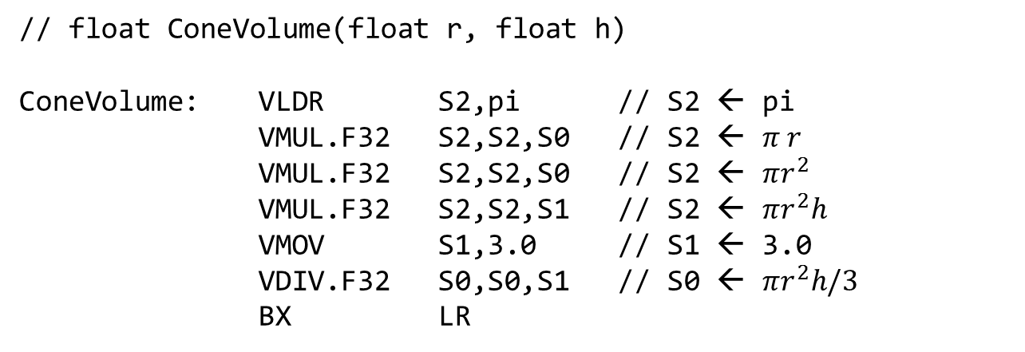
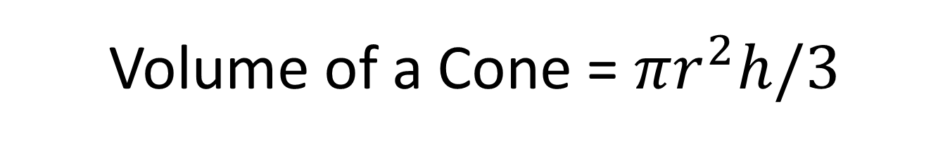
Volume of a Cone = $πr^{2}h/3$
// float ConeVolume(float r, float h)
ConeVolume: VLDR S2,pi // S2 ← pi
VMUL.F32 S2,S2,S0 // S2 ← $π r$
VMUL.F32 S2,S2,S0 // S2 ← $πr^{2}$
VMUL.F32 S2,S2,S1 // S2 ← $πr^{2}h$
VMOV S1,3.0 // S1 ← 3.0
VDIV.F32 S0,S0,S1 // S0 ← $πr^{2}h/3$
BX LR
Replace with a multiply!

Slide 35
FPU Instruction Timing
VADD.F32 S0,S0,S1
Fetch
Decode
Execute
Execute
VMUL.F32 S1,S1,S2
Fetch
Decode
Execute
Execute
VSUB.F32 S2,S2,S3
Fetch
Decode
Execute
Execute
Time
(Clock Cycles)
Many floating-point instructions are specified as taking 1 clock cycle. Even though they actually take 4, pipelining allows them to complete at a rate of 1 instruction per clock. However . . . .

Slide 36
FPU Instruction Stalls
Result of VADD not available until here
VADD.F32 S0,S1,S2
Fetch
Decode
Execute
Execute
VMUL.F32 S1,S1,S0
Fetch
Decode
Stall
Execute
Execute
Time
(Clock Cycles)
When the result of one floating-point instruction is an input operand to the next floating-point instruction, the second instruction stalls for 1 clock while waiting for the result.

Slide 37
Overlapping FPU and Integer Ops
C code | ARM Assembly
int f(int n, float *f) { *f = *f / 7.0 ; return n / 7 ; } | f: VLDR S0,[R1] VMOV S1,7.0` VDIV.F32 S2,S0,S1 LDR R3,=153391683 SMULL R2,R3,R3,R0 ADD R3,R3,R0 ASR R0,R0,2 SUB R0,R3,R0,ASR 31 VSTR S2,[R1] BX LR
The integer and floating-point parts of the CPU operate independently so that integer instructions can be executing while waiting for an VDIV or VSQRT instruction to complete.
f: VLDR S0,[R1]
VMOV S1,7.0`
VDIV.F32 S0,S0,S1
VSTR S0,[R1]
LDR R3,=153391683
SMULL R2,R3,R3,R0
ADD R3,R3,R0
ASR R0,R0,2
SUB R0,R3,R0,ASR 31
BX LR
VDIV
F
D
E
E
E
E
E
E
E
E
E
E
E
E
LDR
F
D
E
E
SMULL
F
D
S
E
SMULL must wait on R3 from LDR
ADD
F
D
S
E
ADD must wait for R3 from SMULL
ASR
F
D
E
SUB
F
D
E
VSTR must wait for S0 from VDIV
VSTR
F
D
S
S
S
S
S
S
E

Slide 38
FPU Programming - Things to Remember
Pass float parameters in S0-S15; integer parameters, pointers and addresses in R0-R3.
The only addressing modes for VLDR and VSTR are [R_{n}] and [R_{n},constant].

Slide 39
FPU Programming - Things to Remember
VPUSH and VPOP only work with FPU registers. Preserve FPU registers by copying S0-S15 into R4-R8 and PUSH/POP'ing R4-R8.
Foo: // S0 = parameter
PUSH {LR}
VPUSH {S16}
VMOV S16,S0
BL bar
…
// use parameter(now in S16)
…
VPOP {S16}
POP {PC}
Foo: // S0 = parameter
PUSH {R4,LR}
VPUSH {S16}
VMOV R4,S0
BL bar
…
VMOV S0,R4
// use parameter(now in S0)
…
POP {R4,PC}

Slide 40
FPU Programming - Things to Remember
VLDR allows "VLDR S_{n},label", but VSTR does not. Use ADR to load the destination address into R_{n} and then use VSTR S_{n},[R_{n}].
There is no VLDR pseudo-instruction, so you can't write "VLDR S_{n},=3.14159". Use .float to create a constant in memory, add a label to it, and use VLDR S_{n},label to load it.

Slide 41
FPU Programming - Things to Remember
VMOV supports a very restricted set on immediate constants. Easiest to only use it to load small integers (like 4.0) and some simple fractions (like 0.5).
VMOV can copy an integer register to a FPU register and vice-versa, but does NOT convert the representation. That requires a combination of VMOV and VCVT.

Slide 42
FPU Programming - Things to Remember
All instructions that perform arithmetic, data type conversion, or compares must specify the operand type, as in VADD.F32. VCVT requires two specifiers.
Comparing two FPU values requires VCMP followed by VMRS APSR_nzcv,FPSCR before the conditional branch or IT block.
A compare against zero must be written as VCMP S_{n},#0.0 (with the #).

Slide 43
FPU Programming - Things to Remember
In an IT block, append the condition code to an FPU instruction BEFORE appending the data type specifier, as in VADDLE.F32
Unlike the integer instructions, constants can't be written as expressions in which all the operands are constants. This also applies to .float directives.
VDIV and VSQRT are SLOW! Overlap their execution with that of integer instructions.

